Slide 1
AlwaysThere™ Virtual Cloud Servers
March 7, 2011

Slide 2
Reasons to Move to the Cloud
Increase business agility
Start small. Scale up and down on demand
Increase IT effectiveness
Spend time on activities that will differentiate your business
Align the cost of IT with the service you receive
Chargeback & pay-per-use
Lower Total Cost of Ownership (TCO)
Leverage economies of scale
Notes:
http://www.radiant.net/blog/index.php/2010/09/29/top-5-reasons-to-get-started-with-enterprise-cloud-computing/

Slide 3
Some of Our Cloud Server Clients…
© 2011 Radiant Communications Corp. All rights reserved.

Slide 4
Why Radiant Cloud Computing?
Customer Service
Open and transparent
Simple Pricing Model
No spreadsheet required
Enterprise-Class Cloud
Premium equipment: VMware-based, private VLANs, MPLS VPN dedicated co-existence, managed service options
Secure Multi-Tenancy Architecture
Notes:
Here’s an example of a complex pricing model: http://calculator.s3.amazonaws.com/calc5.html

Slide 5
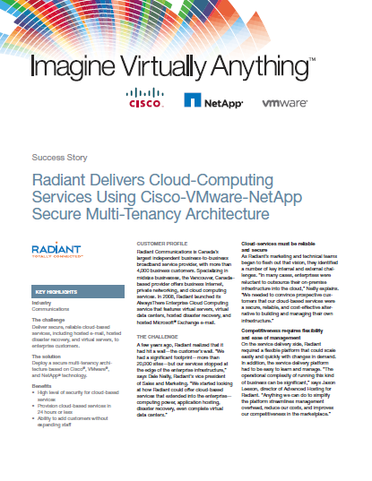
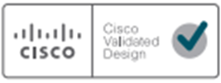
Radiant’s Cloud System Architecture
http://www.imaginevirtuallyanything.com
Notes:
http://www.radiant.net/blog/index.php/2010/11/18/details-matter-in-the-cloud/

Slide 6
Virtual System Administration
Basic ping monitoring
Operating System patching and administration
Monthly OS patching updates
Emergency security updates
Scheduled after hours maintenance window
Managed backup
Daily disk based backup for fast recovery
Offsite replication to Toronto/Vancouver for protection in the event of a site disaster
Operating System | Backup Schedule | Retention Period
Windows Server 2008/2003 | Full database backup: Weekly | Image-level backup: 4 weeks
 | File-level backup: Daily | File-level backup: 28 days
Red Hat Enterprise Linus 5 | Image-level backup: Daily | Image-level backup: 28 days

Slide 7
Microsoft SQL System Administration
Configuration and verification of MS/SQL
Monitoring of database services
Application of MP/SQL patches and service packs
SQL aware managed database backup service
Daily disk based backup for fast recovery
Offsite replication to Toronto/Vancouver for protection in the event of a site disaster
Application | Backup Schedule | Retention Period
SQL Server 2008 | Full database backup: Weekly | Full backup: 4 weeks
 | Incremental database backup: Daily | Incremental backup: 28 days

Slide 8
Radiant’s Cloud: What’s Under the Hood?
Internet
Radiant Network
Real World
Client 1
Client 2
Client 3
Server Cluster
Storage Controllers
Radiant Broadband
Data Centre
Storage Arrays

Slide 9
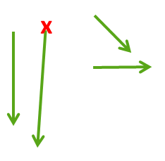
Radiant’s Cloud in Action
Internet
Server Fails
Radiant Network
Real World
Application Grows
Client 1
Client 2
Client 3
Server Cluster
Storage Controllers
Radiant Broadband
Data Centre
Storage Arrays

Slide 10
Radiant’s Cloud Network Architecture
Internet
Vancouver POP
M10i
Toronto POP
M10i
Private Backbone
SA6000
SSL VPN
SSG550
ISG2000
ERX
ERX
GCU
GCU
Last Mile Carriers & Western Canada
Last Mile Carriers & Eastern Canada
Notes:
http://www.radiant.net/blog/index.php/2010/11/18/geography-matters-in-the-cloud/
http://www.radiant.net/data/news/radiant_expands_national_cloud_infrastructure_in_toronto_26_681.php

